Slide 1
CS 332: Algorithms
Merge Sort
Solving Recurrences
The Master Theorem
David Luebke <number> 11/08/26

Slide 2
Review: Asymptotic Notation
Upper Bound Notation:
  f(n) is O(g(n)) if there exist positive constants c and n₀ such that f(n) ≤ c ⋅ g(n) for all n ≥ n₀
  Formally, O(g(n)) = { f(n): ∃ positive constants c and n₀ such that f(n) ≤ c ⋅ g(n) ∀ n ≥ n₀
Big O fact:
  A polynomial of degree k is O(n^{k})
David Luebke <number> 11/08/26

Slide 3
Review: Asymptotic Notation
Asymptotic lower bound:
  f(n) is Ω(g(n)) if ∃ positive constants c and n₀ such that 0 ≤ c⋅g(n) ≤ f(n) ∀ n ≥ n₀
Asymptotic tight bound:
  f(n) is Θ(g(n)) if ∃ positive constants c₁, c₂, and n₀ such that c₁ g(n) ≤ f(n) ≤ c₂ g(n) ∀ n ≥ n₀
  f(n) = Θ(g(n)) if and only if
  f(n) = O(g(n)) AND f(n) = Ω(g(n))
David Luebke <number> 11/08/26

Slide 4
Other Asymptotic Notations
A function f(n) is o(g(n)) if ∃ positive constants c and n₀ such that
f(n) < c g(n) ∀ n ≥ n₀
A function f(n) is ω(g(n)) if ∃ positive constants c and n₀ such that
c g(n) < f(n) ∀ n ≥ n₀
Intuitively,
  o() is like <
  O() is like ≤
  ω() is like >
  Ω() is like ≥
  Θ() is like =
David Luebke <number> 11/08/26

Slide 5
Merge Sort
MergeSort(A, left, right) {
if (left < right) {
mid = floor((left + right) / 2);
MergeSort(A, left, mid);
MergeSort(A, mid+1, right);
Merge(A, left, mid, right);
}
}
// Merge() takes two sorted subarrays of A and
// merges them into a single sorted subarray of A
// (how long should this take?)
David Luebke <number> 11/08/26

Slide 6
Merge Sort: Example
Show MergeSort() running on the array
A = {10, 5, 7, 6, 1, 4, 8, 3, 2, 9};
David Luebke <number> 11/08/26

Slide 7
Analysis of Merge Sort
Statement Effort
So T(n) = Θ(1) when n = 1, and 2T(n/2) + Θ(n) when n > 1
So what (more succinctly) is T(n)?
MergeSort(A, left, right) { T(n)
if (left < right) { Θ(1)
mid = floor((left + right) / 2); Θ(1)
MergeSort(A, left, mid); T(n/2)
MergeSort(A, mid+1, right); T(n/2)
Merge(A, left, mid, right); Θ(n)
}
}
David Luebke <number> 11/08/26

Slide 8
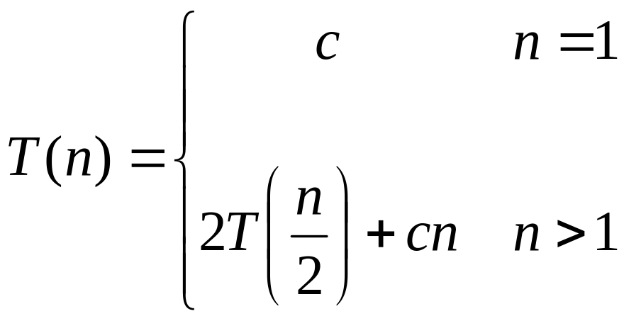
Recurrences
The expression:
is a recurrence.
  Recurrence: an equation that describes a function in terms of its value on smaller functions
David Luebke <number> 11/08/26

Slide 9

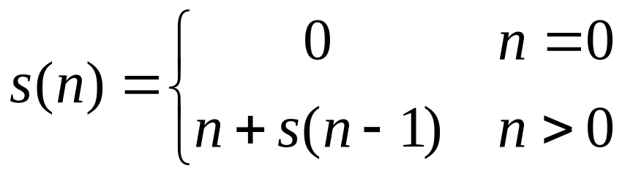

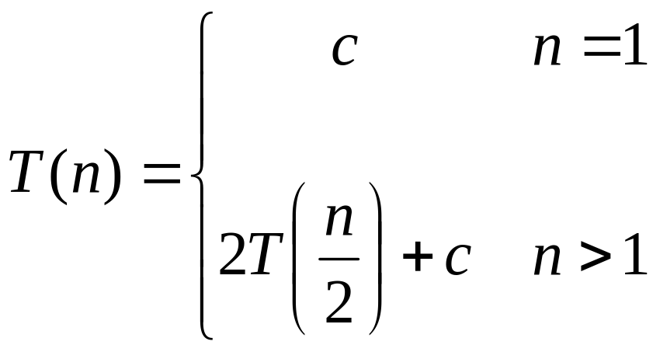
Recurrence Examples
David Luebke <number> 11/08/26

Slide 10
Solving Recurrences
Substitution method
Iteration method
Master method
David Luebke <number> 11/08/26

Slide 11
Solving Recurrences
The substitution method (CLR 4.1)
  A.k.a. the “making a good guess method”
  Guess the form of the answer, then use induction to find the constants and show that solution works
  Examples:
    T(n) = 2T(n/2) + Θ(n) → T(n) = Θ(n lg n)
    T(n) = 2T(⎣n/2⎦) + n → ???
David Luebke <number> 11/08/26

Slide 12
Solving Recurrences
The substitution method (CLR 4.1)
  A.k.a. the “making a good guess method”
  Guess the form of the answer, then use induction to find the constants and show that solution works
  Examples:
    T(n) = 2T(n/2) + Θ(n) → T(n) = Θ(n lg n)
    T(n) = 2T(⎣n/2⎦) + n → T(n) = Θ(n lg n)
    T(n) = 2T(⎣n/2⎦ )+ 17) + n → ???
David Luebke <number> 11/08/26

Slide 13
Solving Recurrences
The substitution method (CLR 4.1)
  A.k.a. the “making a good guess method”
  Guess the form of the answer, then use induction to find the constants and show that solution works
  Examples:
    T(n) = 2T(n/2) + Θ(n) → T(n) = Θ(n lg n)
    T(n) = 2T(⎣n/2⎦) + n → T(n) = Θ(n lg n)
    T(n) = 2T(⎣n/2⎦+ 17) + n → Θ(n lg n)
David Luebke <number> 11/08/26

Slide 14
Solving Recurrences
Another option is what the book calls the “iteration method”
  Expand the recurrence
  Work some algebra to express as a summation
  Evaluate the summation
We will show several examples
David Luebke <number> 11/08/26

Slide 15

s(n) =
c + s(n-1)
c + c + s(n-2)
2c + s(n-2)
2c + c + s(n-3)
3c + s(n-3)
…
kc + s(n-k) = ck + s(n-k)
David Luebke <number> 11/08/26

Slide 16
So far for n >= k we have
  s(n) = ck + s(n-k)
What if k = n?
  s(n) = cn + s(0) = cn
David Luebke <number> 11/08/26

Slide 17
So far for n >= k we have
  s(n) = ck + s(n-k)
What if k = n?
  s(n) = cn + s(0) = cn
So
Thus in general
  s(n) = cn
David Luebke <number> 11/08/26

Slide 18
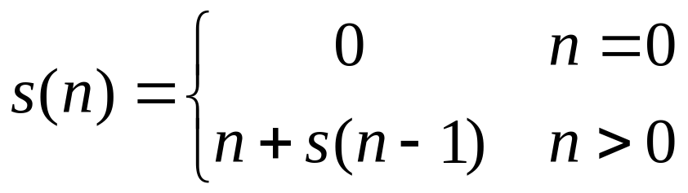
s(n)
= n + s(n-1)
= n + n-1 + s(n-2)
= n + n-1 + n-2 + s(n-3)
= n + n-1 + n-2 + n-3 + s(n-4)
= …
= n + n-1 + n-2 + n-3 + … + n-(k-1) + s(n-k)
David Luebke <number> 11/08/26

Slide 19
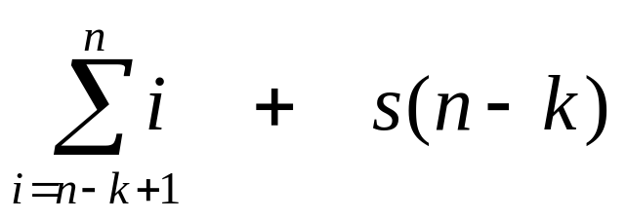
s(n)
= n + s(n-1)
= n + n-1 + s(n-2)
= n + n-1 + n-2 + s(n-3)
= n + n-1 + n-2 + n-3 + s(n-4)
= …
= n + n-1 + n-2 + n-3 + … + n-(k-1) + s(n-k)
=
David Luebke <number> 11/08/26

Slide 20
So far for n >= k we have
David Luebke <number> 11/08/26

Slide 21
So far for n >= k we have
What if k = n?
David Luebke <number> 11/08/26

Slide 22
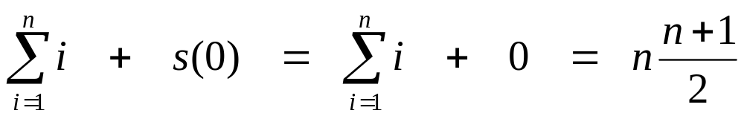
So far for n >= k we have
What if k = n?
David Luebke <number> 11/08/26

Slide 23
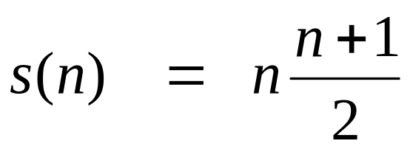
So far for n >= k we have
What if k = n?
Thus in general
David Luebke <number> 11/08/26

Slide 24
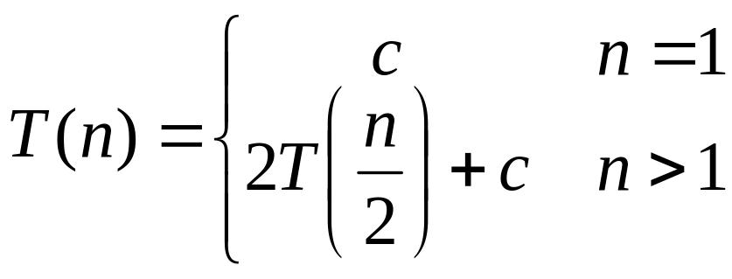
T(n) =
2T(n/2) + c
2(2T(n/2/2) + c) + c
2²T(n/2²) + 2c + c
2²(2T(n/2²/2) + c) + 3c
2³T(n/2³) + 4c + 3c
2³T(n/2³) + 7c
2³(2T(n/2³/2) + c) + 7c
2⁴T(n/2⁴) + 15c
…
2^{k}T(n/2^{k}) + (2^{k} - 1)c
David Luebke <number> 11/08/26

Slide 25
So far for n > 2k we have
  T(n) = 2^{k}T(n/2^{k}) + (2^{k} - 1)c
What if k = lg n?
  T(n) = 2^{lg n} T(n/2^{lg n}) + (2^{lg n} - 1)c
  = n T(n/n) + (n - 1)c
  = n T(1) + (n-1)c
  = nc + (n-1)c = (2n - 1)c
David Luebke <number> 11/08/26

